Slide 1
Heart Disease Prediction using Hybrid Machine Learning Model
Submitted By
Chirudeep Gorle
016682627

Slide 2
Abstract
A serious health problem for many individuals, heart disease is one of the main causes of mortality around the globe.
However, regular clinical data analysis has substantial challenges in diagnosing cardiovascular illnesses such as heart attacks, coronary artery diseases, etc. Early diagnosis of heart disease has the potential to save many lives.
The proposed work proposes a ground-breaking machine-learning method to predict heart illness.
The implementation uses three machine learning algorithms: Random Forest, Decision Tree, and Hybrid Model (a combination of Random Forest and Decision Tree).
The hybrid model has an accuracy rate of 88.7% in predicting heart disease, according to testing results.
To gather the user's input parameter for heart disease forecasting, we used a hybrid model of a Decision Tree and Random Forest in the interface.

Slide 3
INTRODUCTION
With the aid of data mining, a great deal of data may be examined and comprehended. Data extraction and deciding whether to continue with other apps are done using it.
The most often used data mining techniques are clustering, association rule mining, and classifications. Numerous different algorithms may be used to carry out these data mining techniques.
Despite the availability of simulation tools like Weka, Python programming is becoming more and more popular as a result of the methods developed with the Scikit Learn packages. Thus, real-time data mining techniques are more reliable than before.

Slide 4
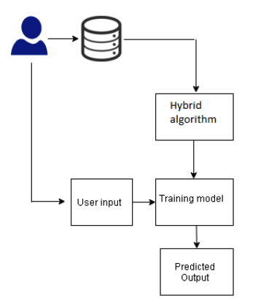
Block diagram of Heart Disease prediction
The major goal is to use an automated medical diagnosis tool to forecast cardiac disease using machine learning.
The best classification approach for prediction is the hybrid model, which is what we are using.
For processing the algorithm, I've picked the Cleveland dataset from Kaggle.
Around 14 attributes and 303 instances are included in the dataset.
I categorize it using a binary classification system, where "0" denotes the lack of heart illness and "1" indicates the existence of heart disease.

Slide 5
RELATED WORK
Currently, researchers are looking at a wide range of recent studies on the analysis and prognosis of cardiac disease. Below is a discussion of these pieces.
The author studies heart illness using random forest and the Cleveland dataset. The author used the Chi-Square feature selection model and a feature selection model based on a genetic algorithm (GA) for the inquiry.
According to the studies that are now accessible, novel research methods and an accurate, optimized model are needed to forecast heart disease.
The current research is described utilizing the currently known machine learning approaches, either implemented using tools like Weka or MATLAB. Additionally, deep learning is utilized in a number of works. However, the enhanced model is not looked into.
The uniqueness of the work is completed by our proposed model. In its implementation, a hybrid model is applied to create better optimum results.

Slide 6
PROPOSED WORK
A cutting-edge technique called a hybrid model uses probabilities from one machine-learning model as input to the other model.
This hybrid model gives us better-optimized outcomes and is taken into consideration for implementation.
The proposed work is implemented using the sklearn libraries, pandas, matplotlib, and other necessary tools. The dataset was retrieved from the UCI repository.
The information that was obtained categorizes heart illness into two groups. In addition to the machine learning technique, the hybrid model, which includes a decision tree and random forest, is used.

Slide 7
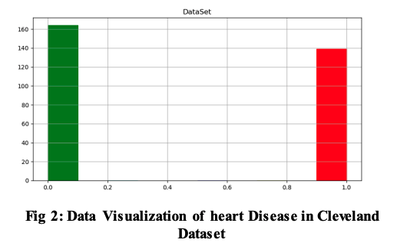
DATASET DETAILS
a collection of data with qualities
sex denotes the patient's gender
age denotes the patient's age
trestbps denotes the resting blood pressure
cp denotes chest pain,
fbs denotes fast blood sugar
chol denotes cholesterol
thalach denotes the highest heart rate reached
restecg denotes the resting electrocardiogram result (1 anomaly)
oldpeak denotes ST depression-induced ex
exang denotes exercise-induced angina
Thalassemia is indicated by the prefix ST and the suffix thal

Slide 8
The following benefits of the suggested process
using two machine learning techniques and a hybrid model.
The accuracy of all described methods shows that the best model exists.
Implement a hybrid model to make the proposed model work as an ideal model.
The approaches listed below are used for the execution.
The data set was gathered from uci.edu.
There is data visualization.
dividing the dataset into training and test data
Use DT and RF models for analysis and training.
Educate the model
Test the trained model and make value predictions.
Utilize a single user input to forecast cardiac disease using a hybrid model.

Slide 9
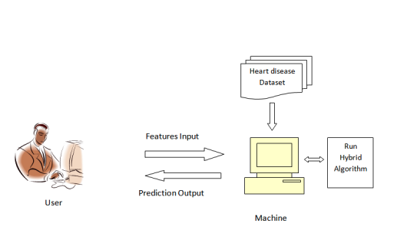
Heart disease prediction system architecture
The user first gives a feature input along with the heart disease dataset, which might include a variety of incidents and traits.
Continuing with the categorization algorithm we choose.
Consequently, after providing the system with all of the inputs and employing machine learning methods like decision trees and regression from random forests
The machine manipulates the dataset generated by the hybrid algorithm.
Finally, it provides the user with a predictable result.

Slide 10
machine learning algorithm models
Decision Tree: The decision tree is one of the learning methods employed to address the classification issue. We divided the dataset into two or more sets using this technique. A decision tree's internal nodes denote a feature test, a branch shows the outcome, and leaves show the conclusions reached after additional processing.
Random Forest Regression: Regression using the random forest method combines numerous judgments into one. Random sampling is used for training characteristics and then random sub-characteristics for sampling nodes.
Separate the train from the test set in the dataset. A feature attribute like that should be included in each subset when creating subsets.

Slide 11
machine learning algorithm models
Hybrid Model: We develop a hybrid model using the decision tree and random forest methods. The combined model runs on random forest probabilities. The train data and probabilities from the random forest are fed into the decision tree algorithm. Similar steps are taken to locate and load test data with decision tree probabilities. Values are predicted at the conclusion.
The projected cardiovascular illness for the provided test dataset is shown using machine learning on a preprocessed dataset.
Users and patients can contribute their own ideas and recognize the risk of heart disease.
A binary prediction type is used to categorize diseases, with 0 being normal and 1 denoting heart disease. The application was created in Python using TkInter.

Slide 12
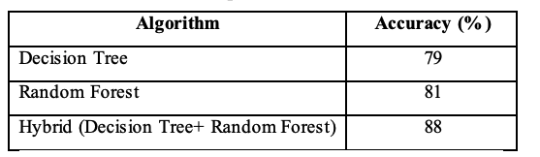
RESULTS AND DISCUSSIONS
The given work was implemented using the Sklearn libraries, pandas, matplotlib, and other relevant tools.
The heart disease dataset that was downloaded from uci.edu will be considered in the study.
Machine learning techniques were used, like in Decision Tree and Random Forest.
In order to improve the work and uniqueness of the task, we developed a hybrid Decision Tree and Random Forest model.
The results show that the Random Forest algorithm and a hybrid model are quite good at spotting cardiac problems.
Decision Tree achieves around 79% accuracy, whereas Random forest and Hybrid models both achieve 88% accuracy.

Slide 13
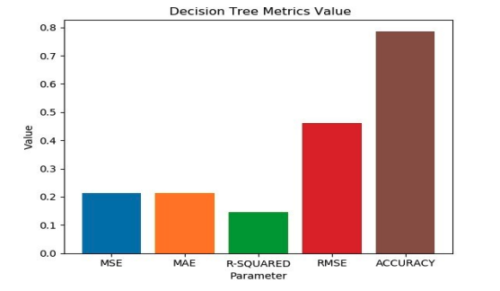
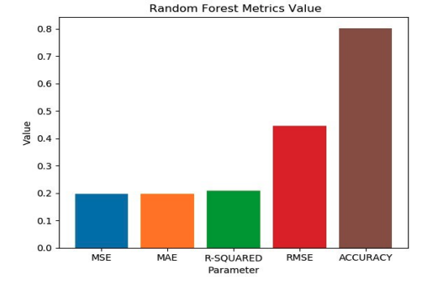
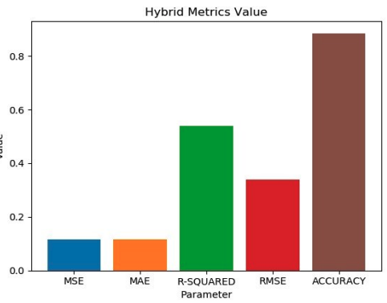
Heart Disease prediction through Various Models
The accuracy for the Decision Tree model is shown in the figure along with the mean square error (MSE), mean absolute error (MAE), R-Squared parameter, and root mean square error (RMSE).
The accuracy for the Random forest model is shown in the figure along with the mean square error (MSE), mean absolute error (MAE), R-Squared parameter, and root mean square error (RMSE).
The accuracy for the Hybrid model is shown in the figure along with the mean square error (MSE), mean absolute error (MAE), R-Squared parameter, and root mean square error (RMSE).

Slide 14
CONCLUSION
Heart disease is one of the potentially lethal conditions that is widespread in the world. A lack of physical exercise and changing lifestyles can enhance the hazard of condition.
The medical industry provides a range of diagnostic techniques. But in terms of accuracy, machine learning is seen to be the greatest choice.
The suggested study uses the TkInter Python program to predict heart illness.
For the prediction of heart illness, the recommended method uses a hybrid model that includes a Decision Tree and Random Forest.
This inquiry makes use of the Cleveland database.

Slide 15
FUTURE WORK
In applications for the healthcare sector, deep learning algorithms are crucial. As a result, applying deep learning algorithms to predict cardiac disease may result in better outcomes. We are also interested in classifying the illness as a multi-class problem in order to assess its severity.

Slide 16
REFERENCES
Jabbar, M. A., B. L. Deekshatulu, and Priti Chandra. "Intelligent heart disease prediction system using random forest and evolutionary approach." Journal of Network and Innovative Computing 4.2016 (2016): 175-184.
Alkeshuosh, Azhar Hussein, et al. "Using PSO algorithm for producing best rules in diagnosis of heart disease." 2017 international conference on computer and applications (ICCA). IEEE, 2017.

Slide 17
Thank you

